Slide 1
ESE 351 Case Study Report Guidelines
Loosely based on report guidelines for ESE 498/499 Capstone projects, including some content from Hiro Mukai (retired Professor and Associate Chair, ESE), and Sandra Matteucci (Director, Engineering Communications, and Instructor, Technical communications), as well as Case Study 1 Reports in ESE 351 Fall 2020

Slide 2
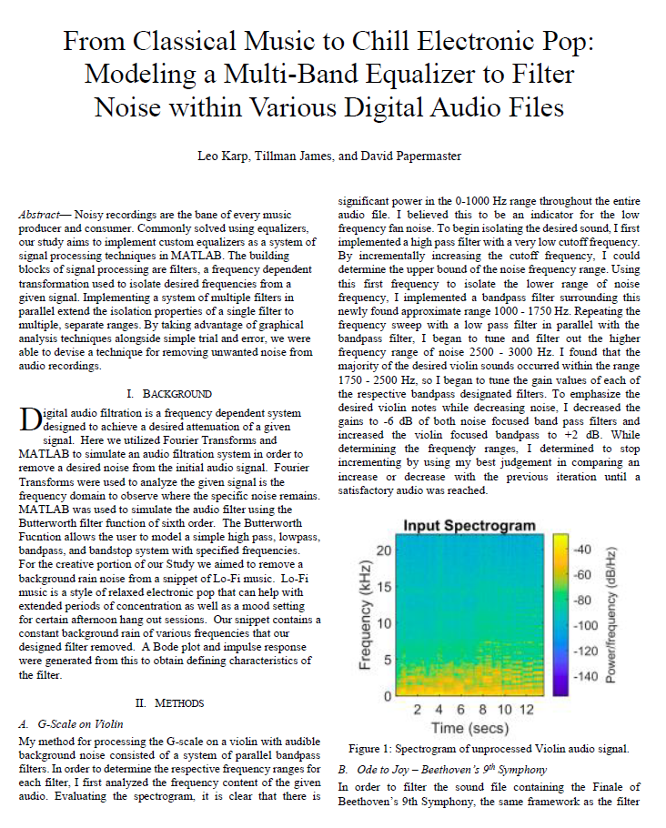
Overall
Format
IEEE two-column enforces concise writing
Main content (text and figures) in 4 pages
Use appendix or supplementary material to include other details
If using IEEE style header, could replace with ‘ESE 351 Case Study #1 Multi-band equalizer’

Slide 3
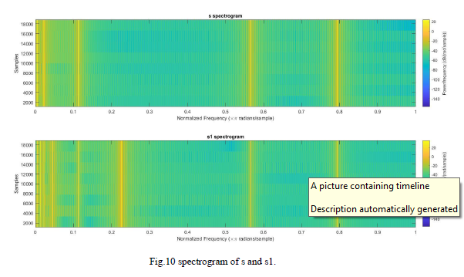
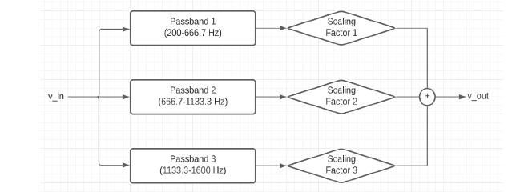
Figures (and tables)
Include block diagrams, figures and tables where appropriate to describe your problem, methods, and results
Include captions and figure/table numbers for all
Mention your tables and figures in the body of the text
Use font sizes and line widths appropriate to figure size on the page
Label all axes and include legends when needed
Gao
Dale, Rinder, and Serpen

Slide 4
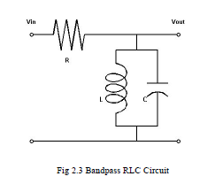
Methods (technical approaches)
Describe how you approached your design objectives
Be specific (within page limit constraints)
Include key equations, and define all variables
Can include description of data in this section
If an approach did not perform as expected, or did not meet the specifications, what alternative approaches were considered and/or attempted?
Alcantara, Dai, Oestrich

Slide 5
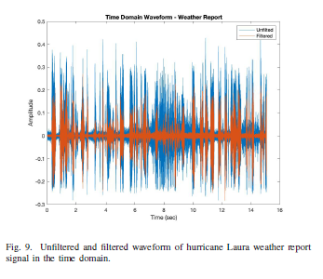
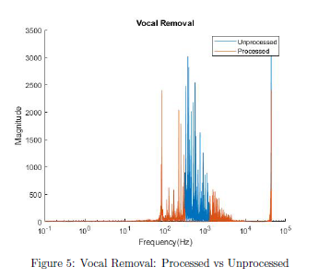
Results
The results are the heart of your project.
They should demonstrate the performance of your design and provide evidence of how well you were able to meet the specifications of the project.
They illustrate the operation of your design and your methods.
Where possible, organize results in tables and figures to summarize cleanly the most important results.
Include interpretation of the data to lead the reader from concept to concept.
Kosins, Ni
Croxford, Jakiela, Wu

Slide 6
Background
Only brief background is needed for these case studies
Introduce relevance of the problem, basic problem statement, and objectives of the project

Slide 7
Conclusions
Highlight main findings of the project
Can include brief discussion (usually a separate section in a longer report)

Slide 8
Title
Notes
Creates a first impression
Influences a reader to continue reading
Conveys topic appropriately and fully
Be specific
Avoid unnecessary words, “A study of…”
Keep it short: 10-12 words
Start with a draft/working title and revisit again at the project end
Case Study 1 Example:
“From Classical Music to Chill Electronic Pop: Modeling a Multi-Band Equalizer to Filter Noise within Various Digital Audio Files”, James, Karp, Papermaster

Slide 9
Abstract (~100-200 words)
An abstract provides a stand-alone summary of your project; a reader should be able to get an idea of your project from the abstract alone. Try to be as specific as possible within the word constraint, while only including significant details. The abstract should
Introduce the problem to be solved or addressed
Describe what you have done to design a solution to part or all of the problem
Describe any technical methods you have used
State the results you have found

